Slide 1
IT-331 ( Computer Graphics 1)
Lecture 7
Two Dimensional Geometric Transformations
[Cont.]
Dr. Mohammed El-Said
Assistant Professor, Computer Science Dept.,
Faculty of Computers & Artificial Intelligence,
Helwan University - Cairo, Egypt.

Slide 2
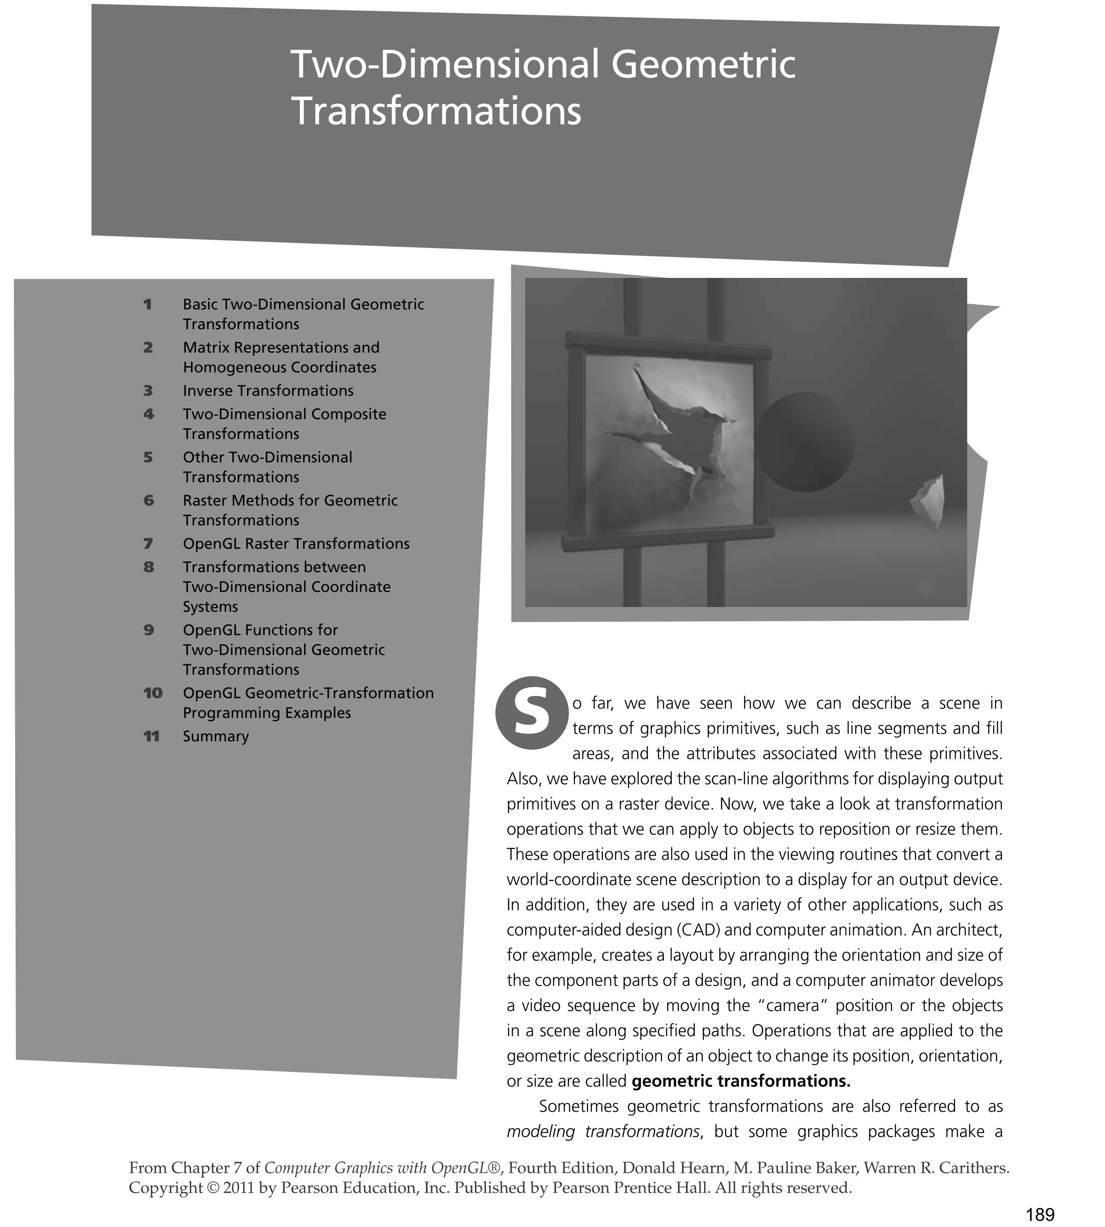

Slide 3
Inverse transformations

Slide 4
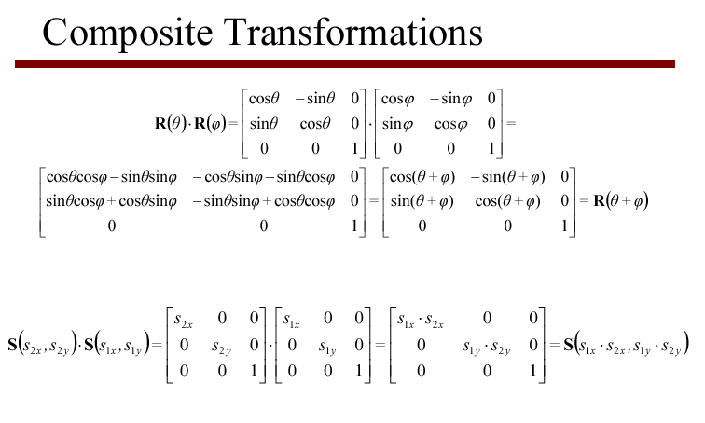

Slide 5
2D Composite Transformations
Combine transformations of different type
translate, rotate, translate
translate, scale, translate
translate, reflect, translate
Use to rotate or scale an object w.r.t. a point that is not the origin
Implement by multiplication of the corresponding homogeneous matrices

Slide 6
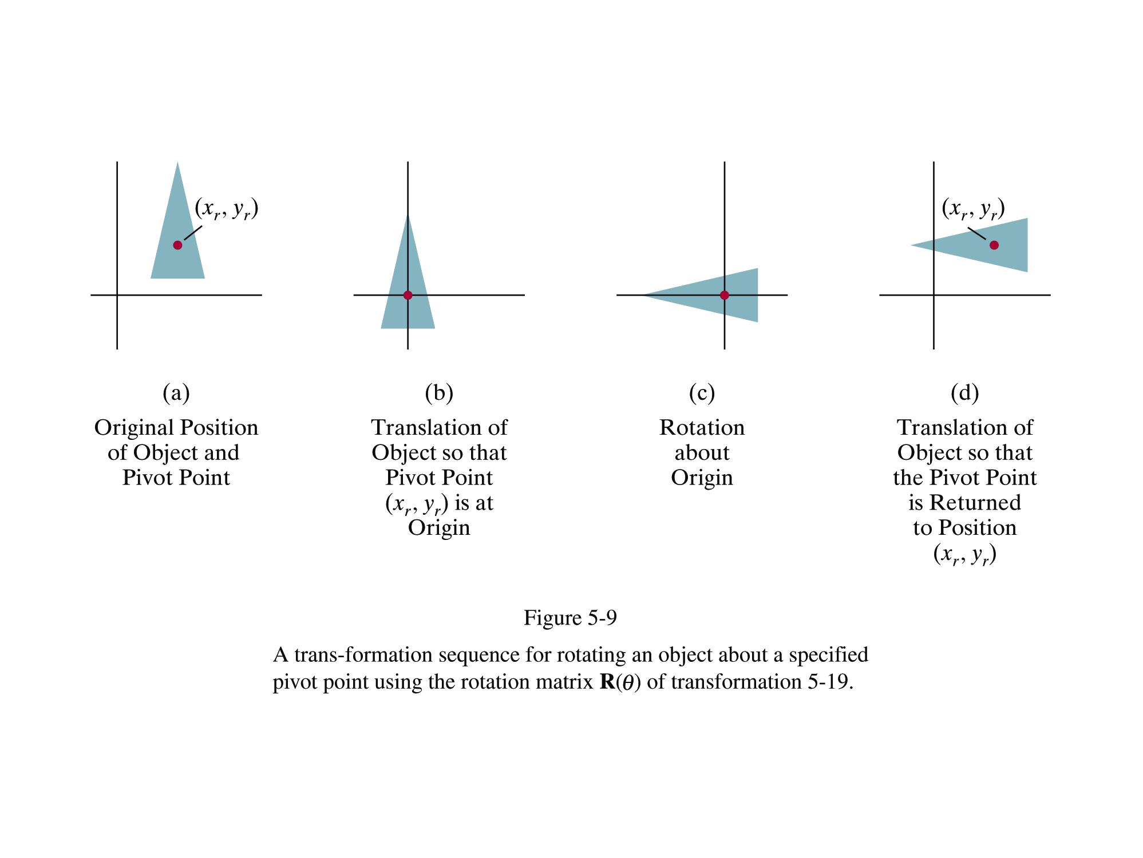

Slide 7
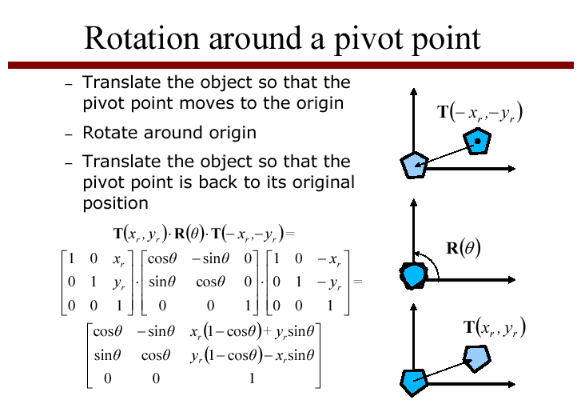

Slide 8
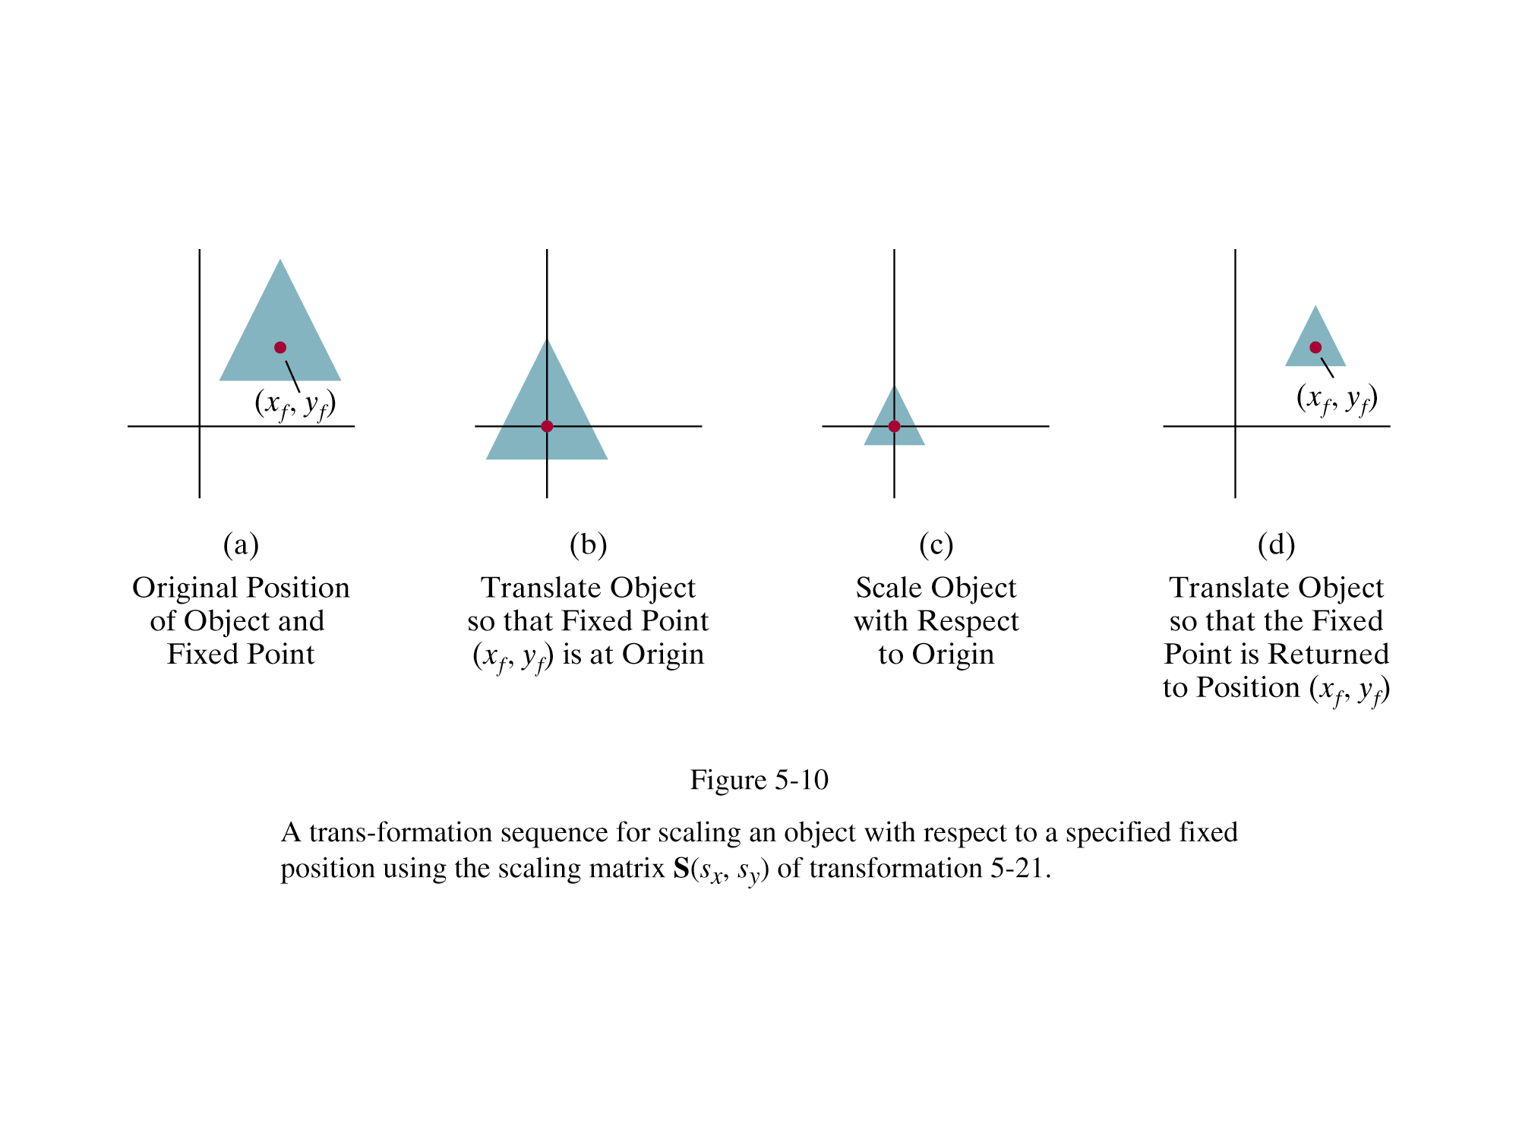

Slide 9
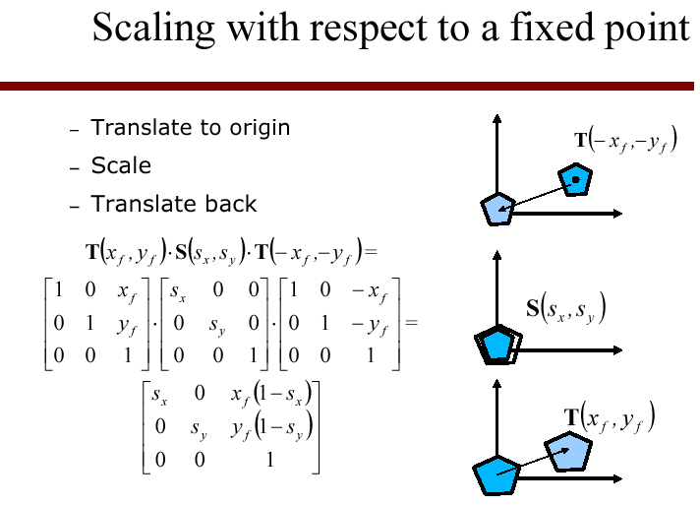

Slide 10
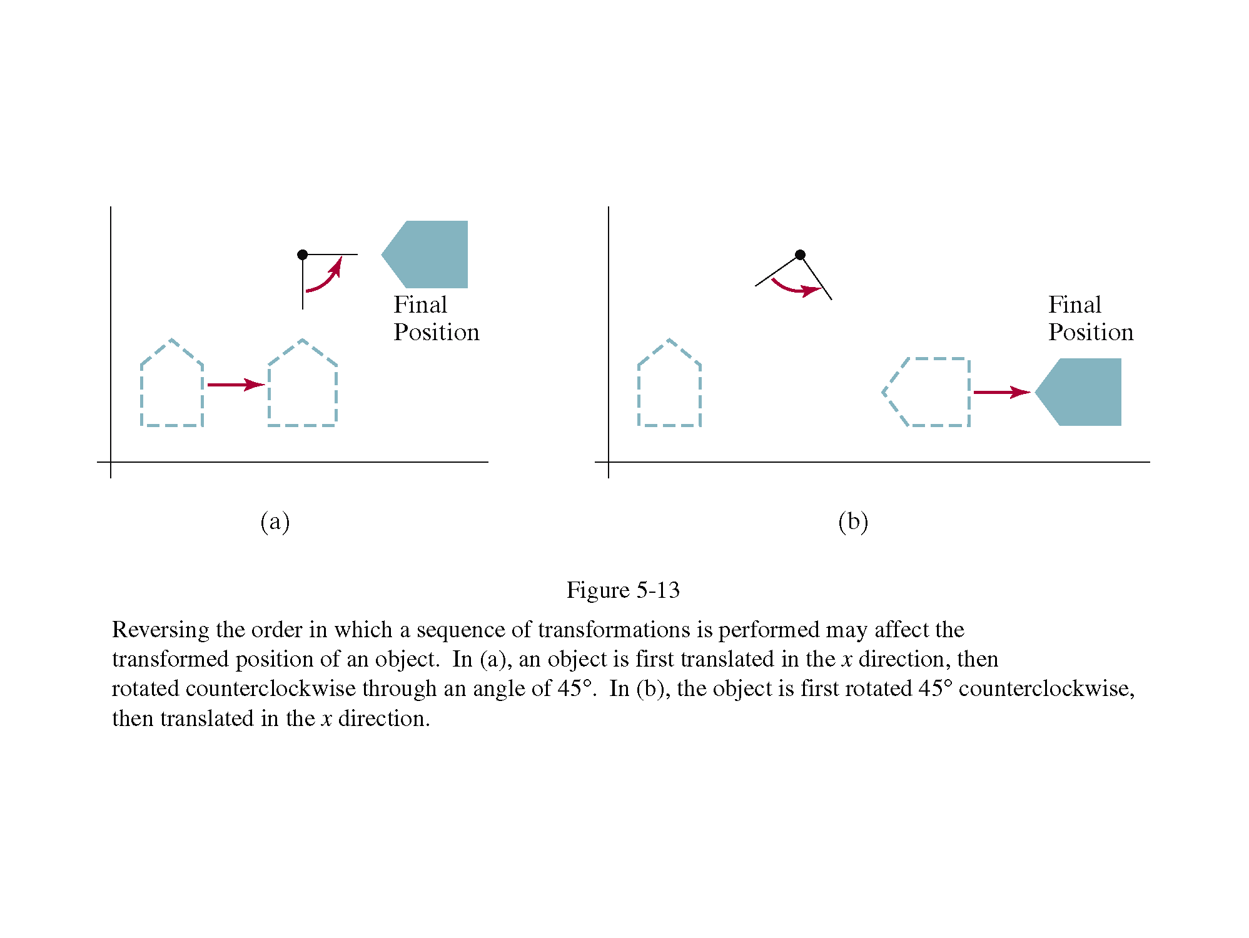
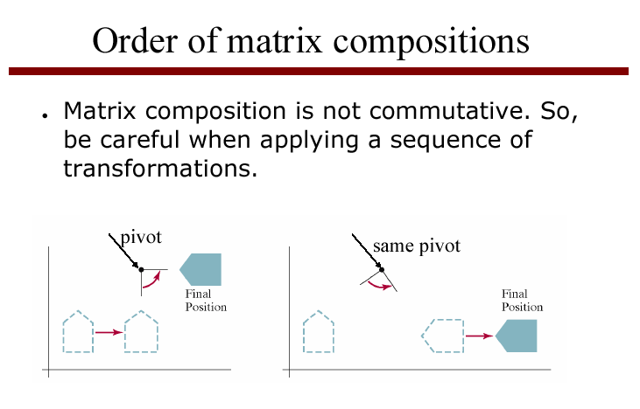

Slide 11
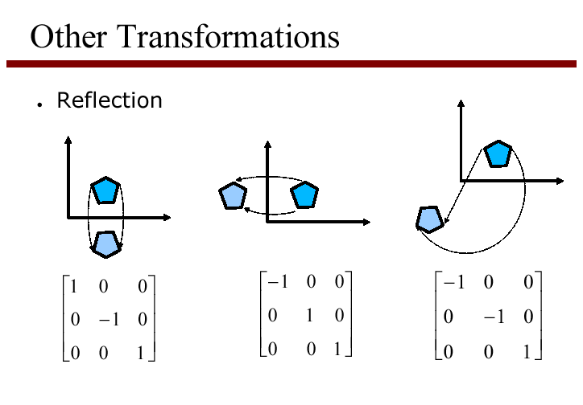
reflection in x and y axes
reflection in origin

Slide 12
Reflect over origin
Reflect over origin:
x’= −x, y’= − y
or
y
x

Slide 13
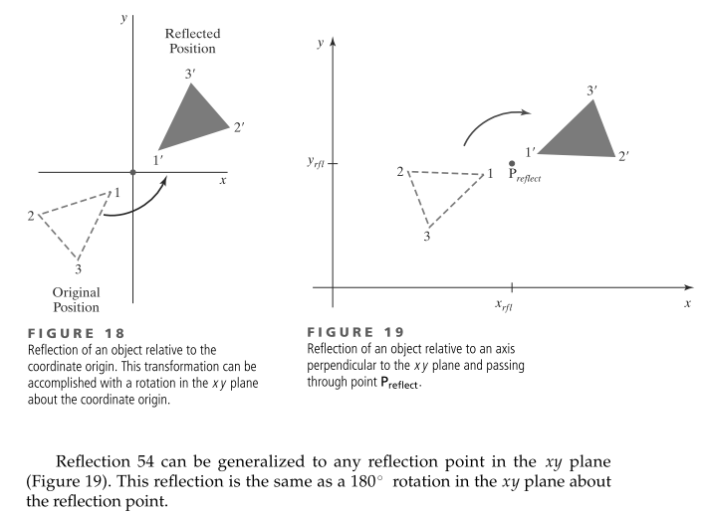

Slide 14
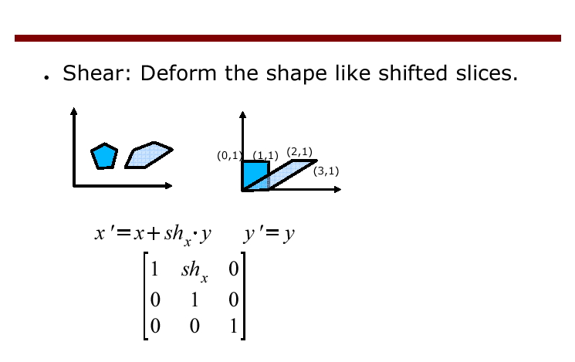
Shear

Slide 15
Shear
Shear in x:
Shear in y:

Slide 16
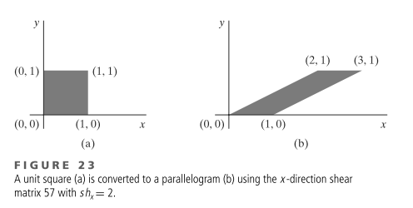

Slide 17
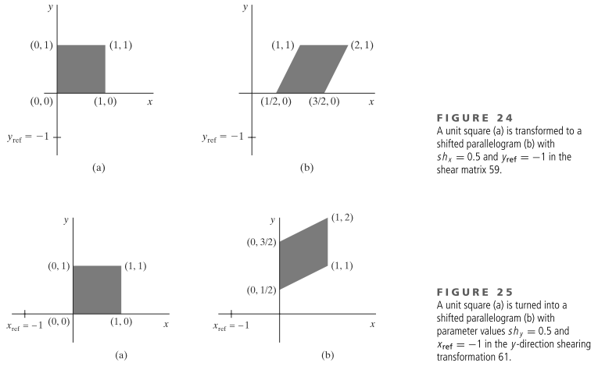

Slide 18
Example 1
S

Slide 19
Example 1
S

Slide 20
Example 1
T(S)

Slide 21
Example 2
S

Slide 22
Example 2
S

Slide 23
Example 2
T(S)

Slide 24
Double Shear: not commutative!

